Slide 1
The Lizard People
A Machine Learning Model on Conspiracy Theories

Slide 2
Team
Karen Gutierrez
Maureen Bayne
Emma Gretter
Nima Motiee
DU Data Science Bootcamp 2021

Slide 3
Background of Data
The Generic Conspiracist Beliefs Scale (GCBS) was created for use in researching conspiracy theories. Research had typically measures beliefs in conspiracies by asking questions about specific conspiracy theories. The GCBS attempts to correct problems with this approach by asking broad questions about assumption that are presumed to underlie such beliefs. The GCBS measures an overall score and five facet scores. The scale was developed by Robert Brotherton, Christopher C. French and Alan D. Pickering of Goldsmiths University of London in 2013.

Slide 4
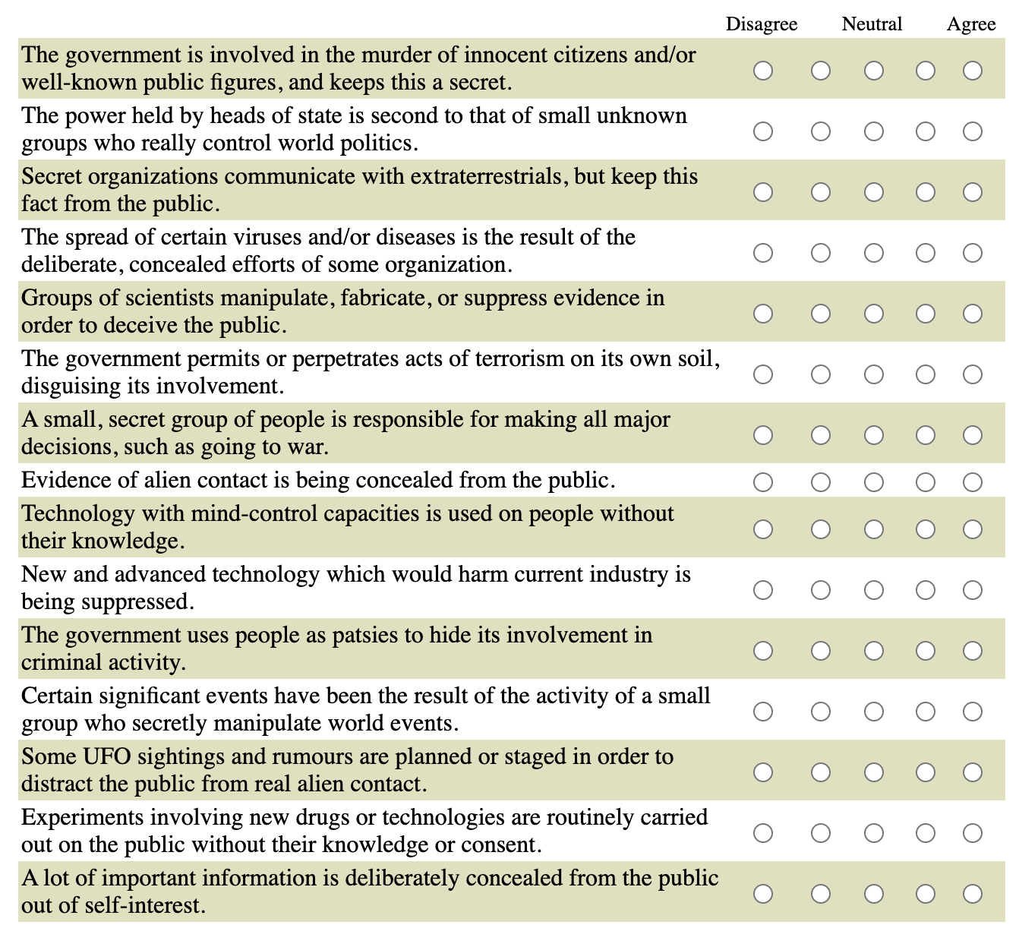
Questions Asked on the Test

Slide 5
Selected Topic
The Lizard People identified Conspiracy Theories as the selected topic of choice.
The selected data consists of the following:
UK Data
15 Questions (see previous slide)
Taker must rate on scale of 1=Disagree, 3=Neutral, and 5=Agree given statement
Contains 2,495 questionnaire answers
Spans the year 2013

Slide 6
Questions we would like to answer:
What answers to certain questions lead to a higher or lower score?
Is there a pattern of specific types of answers that lead to a Higher or Lower score?
Are there certain characteristics of a conspiracy theorist? (i.e. Educated vs Uneducated)

Slide 7
Reasons
The group were intrigued by conspiracy theories given the rise of conspiracies across the mainstream over the past 5 years. The group decided it would be interesting to dive into data concerning conspiracy theories to gauge and quantify the types of characteristics of a conspiracy theorist.

Slide 8
Technologies, Languages, and Tools
Python
HTML
JavaScript
SQL
Jupyter Notebook
CSS
VS Code
PgAdmin

Slide 9
Data Source and Citations
Web Data Source: https://www.kaggle.com/yamqwe/measuring-belief-in-conspiracy-theories
Github Repo:
https://github.com/karengut97/Conspiracy_Theory_Final

